Slide 1
FIL251 2019
WEEK 2: Utilitarianism

Slide 2

WHAT IS PHILOSOPHY?
Philosophy begins with wonder…
The investigation of fundamental problems
What is real?
How do we know anything?
What is the best way to live?

Slide 3
The Branches of PHILOSOPHY
Metaphysics: What is reality?
Epistemology: What is knowledge?
Ethics: What is the right thing to do?
Aesthetics: What is beauty?
Logic: What is good reasoning?

Slide 4
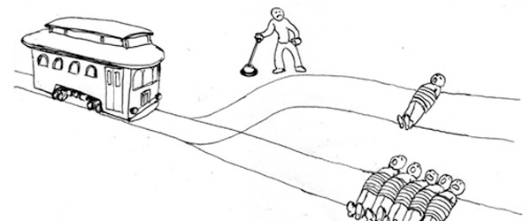
Moral reflection: The Trolley Problem

Slide 5
3 DIMENSIONS OF ETHICAL THINKING
Moral Reflection
Moral Arguments
Moral Agency

Slide 6
Corruption definition
A process whereby a thing becomes decayed, useless, dysfunctional, or characterized by actions which lead to such outcomes.
In the institutional sense? An institution is corrupt when it becomes decayed, useless, dysfunctional, or characterized by actions which lead to such outcomes.

Slide 7
Government corruption
The understanding of what corruption is involves ideas of the state, not just personal morality of civil servants
The Liberal (Neutral) State
I decide what is a good life for myself. The state is there to provide services for everyone to achieve their conception of the good life.
Liberal Freedom protected by Neutral Bureaucracy
Bureaucracy: measures put in place by a state to enable it to function effectively
Bias/Self-interest leads to Corruption!
Apartheid versus post-1994

Slide 8
Good government
Competing ideas of how a good government should function
Duties versus virtues
Role of civil servants:
Dilemma: Laws/rules versus principles of what is good for the public
Public Welfare

Slide 9
Corporate corruption
What is a business?
A FOR-PROFIT venture
Competing ideas of the correct functioning of a business
Business responsibilities:
Shareholders
Stakeholders

Slide 10
Defining Corporate Corruption:
Government Corruption = private interests over public duties
Corporate Corruption = private interests over professional responsibilities
Moral Responsibilities of business and business professionals to shareholders/stakeholders:
Financial
Political
Social
Environmental

Slide 11
Combating corruption
World Economic Forum’s 3 Key Steps:
Focus on Ethics Education
Create a Culture of Integrity
Demand Accountability

Slide 12
Competing Moral Theories
The good thing to do is to act for the welfare of as many people as possible (Utilitarianism)
The good thing to do is to follow rules (Deontology)
The good thing to do is to develop your character (Virtue Ethics)
The good thing to do is to act in the interests of harmony and relationships (Ubuntu)

Slide 13
NB REMINDERS
Tutorial sign-up sheets are up.
Tutorials are compulsory
Email policy
Subject Line: [YOUR TUTORS NAME] [YOUR TUTORIAL SLOT]
No questions that can be answered by checking the Study Guide
No content discussed over email – come to consultation
Tuesdays 9.30am – 11.30am
72-Hour Rule
All mark queries must be made within 72 hours of the marks being released
Prepare for Class Tests
Class Rep

Slide 14
Utilitarianism: bentham
The cabin-boy thought experiment
Was the killing of the cabin boy morally permissible?
Defense: it was necessary to kill one person to save three
Objection 1: there could be even worse consequences for the majority after the death
This objection accepts the utilitarian assumption that morality consists in weighing costs and benefits, and simply wants a fuller reckoning of the social consequences

Slide 15
Cabin Boy thought experiment
Objection 2: There is a nagging sense that killing and eating a defenseless boy is wrong for reasons that go beyond the calculation of social costs and benefits
This objection rejects the idea that the right thing to do is simply a matter of weighing consequences; it suggests that morality is something more to do with the proper way for human beings to treat each other. Certain duties and rights should command our respect, for reasons independent of the social consequences

Slide 16
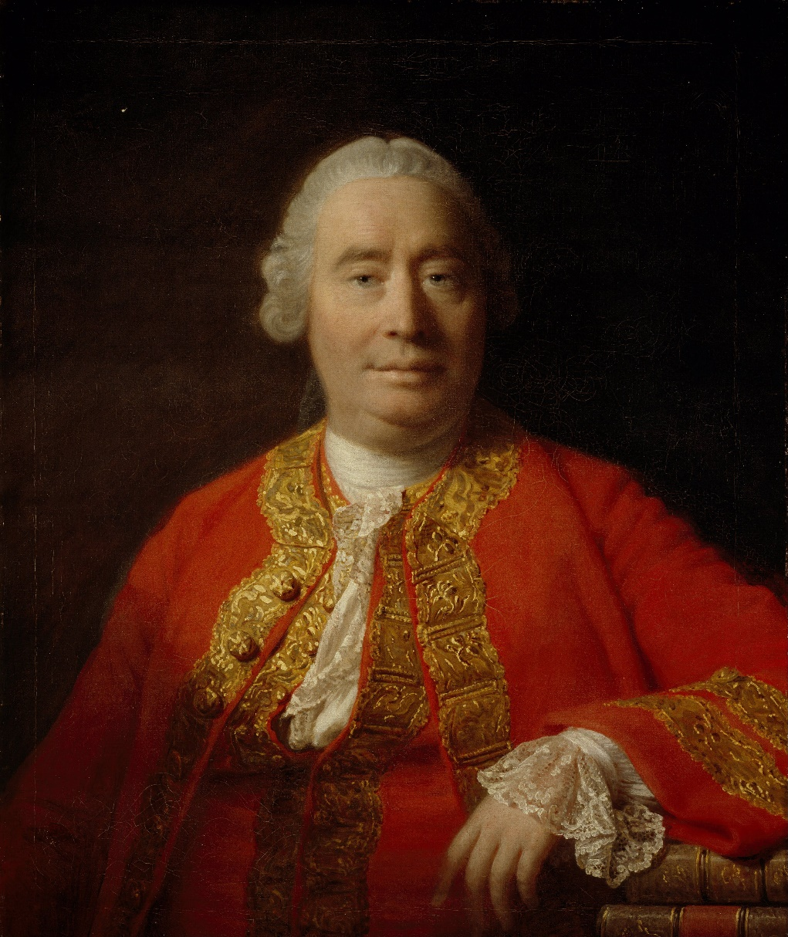
Jeremy bentham (1747-1832)
The right thing to do is to maximize utility
Utility is whatever produces pleasure or happiness, and whatever prevents pain or suffering
The Greatest Happiness Principle:
Consequentialist ethics

Slide 17
Utilitarianism Objections
Two objections:
1. It fails to respect individual rights
The city of happiness
Throwing Christians to lions
2. Common currency of value: cost-benefit analysis
Exploding gas tanks
Pain for pay – what would you pay?
St. Anne’s girls – paying money to sleep over

